Slide 1

Go Serverless with Azure Functions
Paul Yuknewicz (@paulyuki99)
Head of Product
Azure Serverless

Slide 2
Doing more
+
2
with less
–
Notes:
We are going through a period of historic economic, societal and technological change. But for all the uncertainty we continue to see in the world, one thing is clear: organizations in every industry are turning to you to help them do more with less, so that they can navigate this change and emerge much stronger.
You are the change agents who make doing more with less possible – less time, less cost, less complexity, with more innovation, more agility and more resilience.
Doing more with less doesn’t mean working harder or longer.
It means applying technology to amplify what you can do, and ultimately, what an organization can achieve amidst today’s constraints.

Slide 3

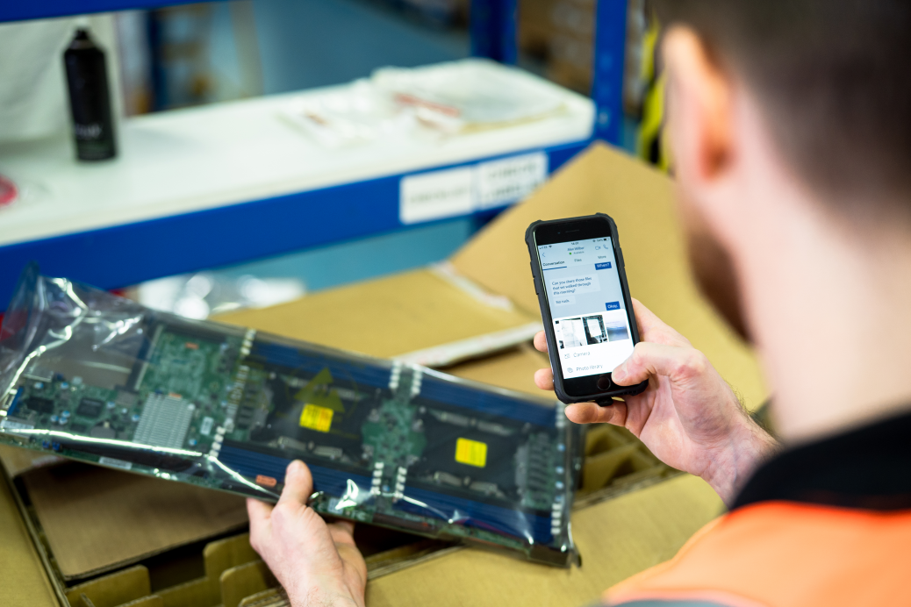

Serverless is redefining the way we build cloud native applications
Retail
Manufacturing
Banking/finance
Notes:
The app of the future is cloud native.
- Designed to take full advantage of the latest innovation in public cloud
- Intelligent, and infused with AI to provide advanced insights
- Quickly able to incorporate open-source technology and libraries from across the globe
Cloud native technology is how developers can achieve the agility, reliability, and security demanded by the next generation of applications call back to the challenges

Slide 4
Evolution of computing
Serverless
Containerization
Level of abstraction
PaaS
Virtual machine
Physical server
Focus on business logic
Notes:
The app of the future is cloud native.
- Designed to take full advantage of the latest innovation in public cloud
- Intelligent, and infused with AI to provide advanced insights
- Quickly able to incorporate open-source technology and libraries from across the globe
Cloud native technology is how developers can achieve the agility, reliability, and security demanded by the next generation of applications call back to the challenges

Slide 5
What is serverless?
No infrastructure management
Developers can just focus on their code—without needing to worry about provisioning and managing infrastructure
Instant, event-driven scalability
Application components react to events and triggers in near real-time with virtually unlimited scalability
Pay-per-use
Only pay for what you use: billing is typically calculated on the number of function calls, code execution time, and memory used*
*Supporting services, like storage and networking, may be charged separately.
Notes:
Many modern applications are rapidly adopting event-driven serverless architecture due to the increased demand for real-time application integration and data movement. Event-Driven applications are built with a serverless approach that uses event-driven functions, event routing services, and API management.
Serverless offers increased agility, improved resilience and scalability, and an on-demand consumption-based cost model. By 2025, over 50% of enterprises will have deployed serverless, compared to 20% today
Event-driven applications are ideal for enterprise scenarios that derive the most benefit from scalable and reliable real-time communication, such as IoT, e-commerce, financial applications
You can maximize the benefits of microservices by using event-driven architecture to communicate between decoupled services through events while maintaining independence, abstraction, and flexibility
With Azure you can ingest billions of events with Azure Event Grid and use Azure Functions to processes the events in near-real time

Slide 6
FaaS is at the center of serverless
Functions-as-a-Service programming model use functions to achieve true serverless compute
Single responsibility
Functions are single-purposed, reusable pieces of code that process an input and return a result
Short-lived
Functions don’t stick around when finished executing, freeing up resources for further executions
State managed
Functions don’t hold any persistent state and don’t rely on the state of any other processes; Durable Functions allow statefulness at scale
Event-driven and scalable
Functions respond to predefined events, and are instantly replicated as many times as needed

Slide 7
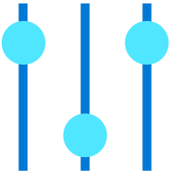
Azure Functions
An event-based, serverless compute experience that accelerates app development
End-to-end developer experience
Take advantage of a complete, end-to-end development experience with Functions—from building and debugging locally on major platforms like Windows, macOS, and Linux to deploying and monitoring in the cloud
Event-driven programming model
Use built-in triggers and bindings to define when a function is invoked and to what data it connects; use durable functions for state
Run and deploy anywhere
Choose Azure Functions Consumption, Apps Service or Elastic Premium dedicated plans, Kubernetes, multi cloud, on prem and edge, and local machine
Fully managed and cost-effective
Automated and flexible scaling based on your workload volume, keeping the focus on adding value instead of managing infrastructure

Slide 8
End-to-end development experience
Azure
Multi-platform “Core Tools” CLI
Local functions runtime
Visual Studio E2E experience & debugging
Visual Studio Code extension
CI/CD on Github and AzDO
Eventgrid emulation (early Preview)
Storage emulation using Azurite
Local
Develop
Debug
Deploy

Slide 9

Azure Functions is an open-source project
Functions runtime and all extensions are fully open-source
Azure Functions Core Tools lets you develop and test your functions on your local computer from the command prompt or terminal, and the local functions can connect to live Azure services
+
Learn more | https://github.com/Azure/Azure-Functions
Notes:
Azure Functions is open source allowing the community to contribute to the future of the service and allows customers to run Functions anywhere – on Azure, in your datacenter, in other public clouds, and notably in Kubernetes using KEDA to scale based on events. This reinforces our commitment to addressing the multi-cloud needs of our customers.

Slide 10
DEMO
Developer Experience

Slide 11

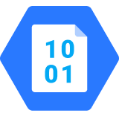
Integrated programming model
Triggers to handle events
Input bindings to get data in easily
Output bindings to push data out easily
Simplified bindings attributes in .NET 6/7 and Python
C#, Java, Python, Node.js, PowerShell
Durable Functions (more later..)
Trigger object
Your code
Input object
Output object
Input binding
Trigger
Input binding

Slide 12

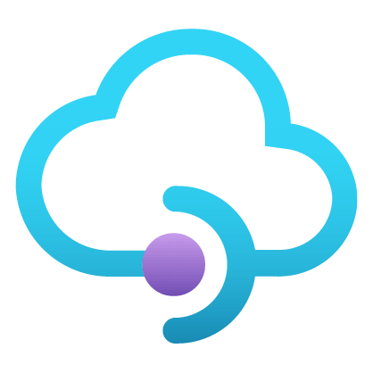
Workflows and orchestration with Durable Functions
PATTERNS/USE CASES
Durable Functions is an extension of Azure Functions that lets you write stateful functions in a serverless compute environment
Manageable sequencing + error handling/compensation
Fanning out and fanning in
External events correlation
?
Start
Get status
Flexible automated long-running process monitoring
Http-based async long- running APIs
Human interaction
Notes:
Imagine a scenario where I have to take the output of a Function and use it as the input to call another Function. I’ll have to coordinate the chaining manually.
If I have to have a function that takes some sort of event and then parallelizes it into multiple Functions, I can still do that but how will I know when all Functions have finished executing so I can aggregate the results and move on.
What if I had to listen on multiple events and aggregate their outcome to determine which specific job or function to run in my application.
What if I wanted to do some kind of extended monitoring on an endpoint? For example, if I were to monitor the temperature of a remote machine and take action x if the temperature were lower than a certain threshold, else do y or run job y.
What if I have an API or endpoint that was running for a long time? I know Functions are short-lived but sometimes you guys put some serious load on them. Could there be a mechanism to provide status of the execution back to the client so they’re not left hanging?
And lastly, what if I wanted to get some sort of human interaction in there? For example, if I am to do some sort of 2FA in the middle of my function execution but also don’t want to wait forever because sometimes people take forever to reply especially when the texts are automated.
Today, I’m going to be talking about some of these problems – how you can approach them in regular FaaS? And how they can be simplified with the technology of Durable Functions.

Slide 13
DEMO
Programming Model

Slide 14
Fully managed and cost-effective
Automatically handles all maintenance and updates
Serverless and auto scale options keep costs low by matching resources to demand and eliminating capacity management and resource over-provisioning during busy or slow times
Cost-effective serverless model responds to app patterns and is ideally suited for small, spiky workloads with moderate performance requirements
Demand
Resources

Slide 15
Hosting options flexibility
Pick the Functions plan that matches your business needs and deploy the same code to multiple targets—from pay-per-execution in the cloud to your Kubernetes cluster or IoT devices for edge computing.
Consumption
Premium
App service
Kubernetes
Azure stack
IoT Edge
Notes:
Consumption plan: Pay only for what you use, charges apply per execution and per GB-second
Premium plan: Get the best of both serverless and dedicated hosting - you can leverage fast, dynamic scale while benefiting from consistent performance avoiding cold start, network isolation, and more predictable costs.
App Service plan: Run your functions on the same resources you already have dedicated for web apps on an App Service plan
Kubernetes: Add event-driven autoscaling and triggers to your Kubernetes clusters by hosting serverless functions in containers with KEDA
Azure Stack: Bring the power of serverless functions along with the entire Azure stack to your own data centers
IoT Edge: Deploy custom Azure modules on IoT devices

Slide 16




Functions on Kubernetes
Hybrid solutions
Some data needs to be processed on-premises
Compliance and consistency
Azure policy or compliance requirements
Specific compute requirements
(e.g., GPUs, high memory)
Leverage existing Kubernetes investments
Notes:
There’s no better way to leverage the serverless advantages than using a fully managed service in the cloud like Azure Functions, but some applications might need to run on disconnected environments, or require custom hardware and dependencies. Customers usually take a containerized approach for these scenarios, in which Kubernetes is the de facto industry standard.
Managing event-driven aware applications in these environments is non-trivial and usually insufficient, as it’s based only on resource usage, such as CPU or memory. And when you run out of those, it’s often too late as your application may already be failing.
It may also be as simple as wanting to leverage an existing Kubernetes clusters that you have.

Slide 17
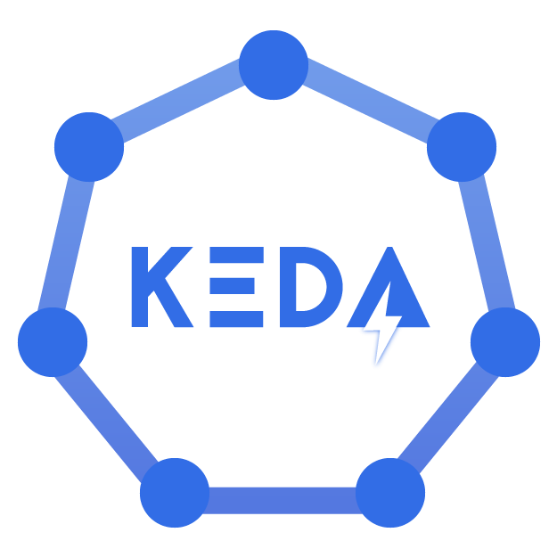
Kubernetes-based event-driven autoscaling
Open-source component to provide function-like scale in Kubernetes for any container
Azure Functions native tooling and trigger support
Scale to zero or scale to thousands
Learn more | https://github.com/kedacore/keda
Notes:
KEDA is a product out of a partnership between Microsoft and Red Hat. KEDA means Kubernetes Event-Driven Autoscaling.
KEDA is an open source component for Kubernetes that provides event-driven scale for any container workload, enabling containers to scale from zero to thousands of instances based on event metrics like the length of an Azure Queue or Kafka stream, and back to zero again when done processing.
Since Azure Functions can be containerized, you can now deploy a Function App to any Kubernetes cluster keeping the same scaling behavior you would have on the Azure Functions service.

Slide 18
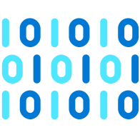
KEDA
Kubernetes cluster
Scaledobject
Kubernetes API Server
KEDA
Metrics adapter
Horizontal
pod autoscaler
Controller
Scaler
External
trigger
source
Workload
Notes:
KEDA, in a nutshell, will exist within your cluster and based on your choice of autoscaler, will monitor the events coming in and adjust your workload accordingly. As more events are coming in or as a Queue becomes larger, KEDA will automatically create more containers to handle the workload surge.

Slide 19
DEMO
Code to Cloud to Edge

Slide 20
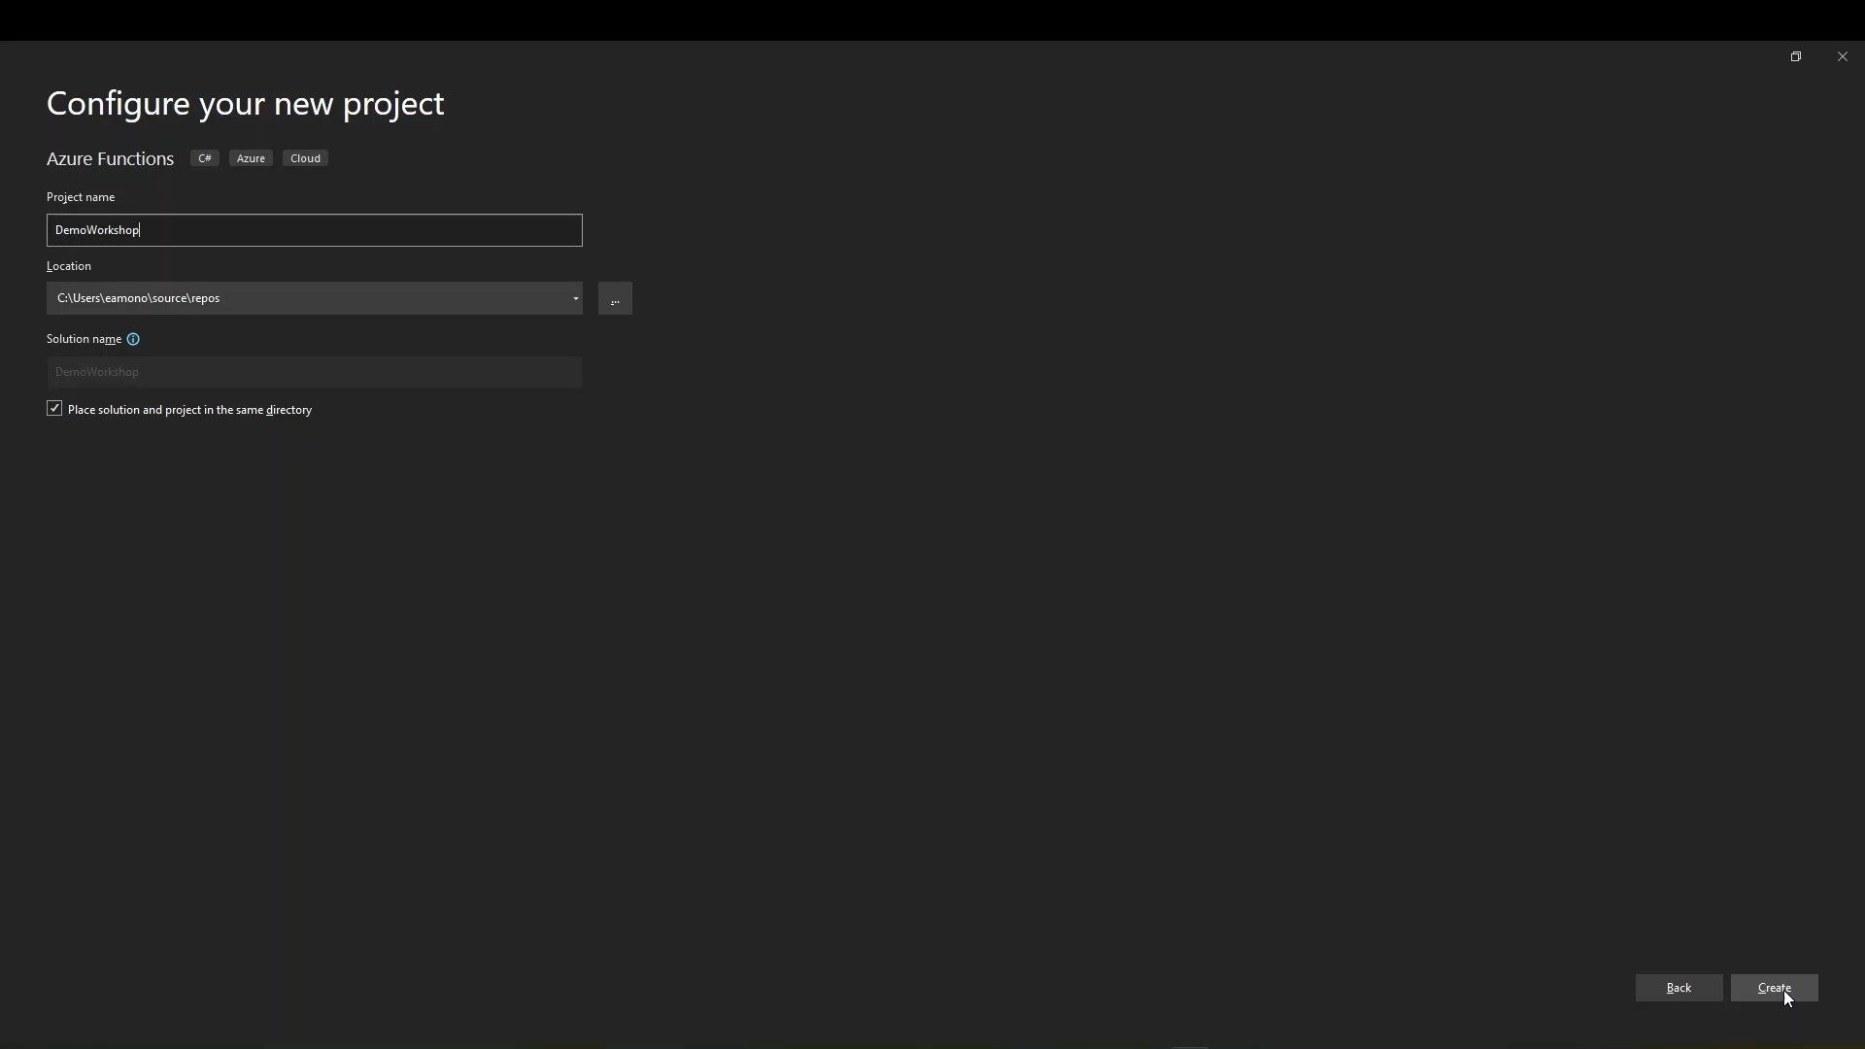

Slide 21
Common Functions scenarios
Machine learning
Real-time stream processing
Workflows and orchestration
Scheduled task automation
IoT-connected backends
Web/Mobile application backends

Slide 22
Common scenarios

Slide 23
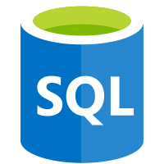
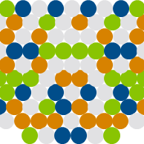
Automation of scheduled tasks
SCENARIO EXAMPLE
Financial services
A customer database is analyzed for duplicate entries every 15 minutes, to avoid multiple communications being sent out to same customers
A function cleans a database every 15 minutes…
…deduplicating entries based on business logic

Slide 24
Real-time stream processing
SCENARIO EXAMPLE
ISV
Huge amounts of telemetry data is collected from a massive cloud app. That data is processed in near real-time and stored in a DB for use in an analytics dashboard
App or device producing data
Event Hubs ingests telemetry data
Data used for dashboard visualizations
A function processes the data…
…and sends it to Cosmos DB

Slide 25
Workflows and orchestration with Durable Functions
PATTERNS/USE CASES
Durable Functions is an extension of Azure Functions that lets you write stateful functions in a serverless compute environment
Manageable sequencing + error handling/compensation
Fanning out and fanning in
External events correlation
?
Start
Get status
Flexible automated long-running process monitoring
Http-based async long- running APIs
Human interaction
Notes:
Imagine a scenario where I have to take the output of a Function and use it as the input to call another Function. I’ll have to coordinate the chaining manually.
If I have to have a function that takes some sort of event and then parallelizes it into multiple Functions, I can still do that but how will I know when all Functions have finished executing so I can aggregate the results and move on.
What if I had to listen on multiple events and aggregate their outcome to determine which specific job or function to run in my application.
What if I wanted to do some kind of extended monitoring on an endpoint? For example, if I were to monitor the temperature of a remote machine and take action x if the temperature were lower than a certain threshold, else do y or run job y.
What if I have an API or endpoint that was running for a long time? I know Functions are short-lived but sometimes you guys put some serious load on them. Could there be a mechanism to provide status of the execution back to the client so they’re not left hanging?
And lastly, what if I wanted to get some sort of human interaction in there? For example, if I am to do some sort of 2FA in the middle of my function execution but also don’t want to wait forever because sometimes people take forever to reply especially when the texts are automated.
Today, I’m going to be talking about some of these problems – how you can approach them in regular FaaS? And how they can be simplified with the technology of Durable Functions.

Slide 26

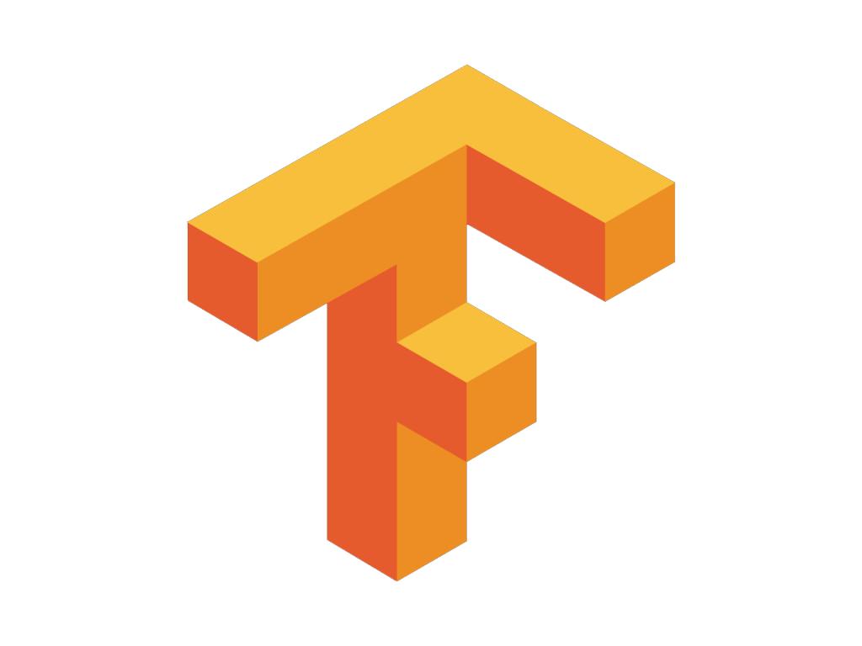
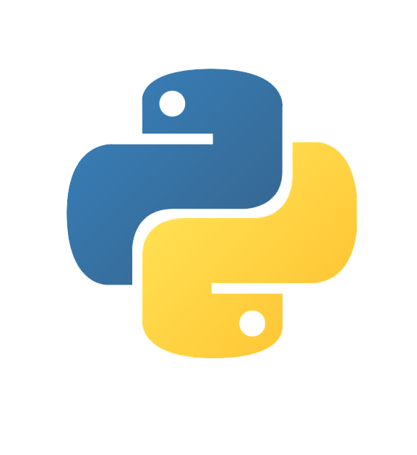
Machine Learning
SCENARIO EXAMPLE
Image Classification Service
Images are ran through a TensorFlow model to perform classification on a stream of images
Classification requests
Classification results
Queue
. . .
SignalR service
Azure Functions

Slide 27
Web application backends
SCENARIO EXAMPLE
Retail
Online orders are picked up from a queue, processed and the resulting data is stored in a database
Request made in a web app
Request queued in Service Bus
A function processes the request…
…sends output to Cosmos DB

Slide 28
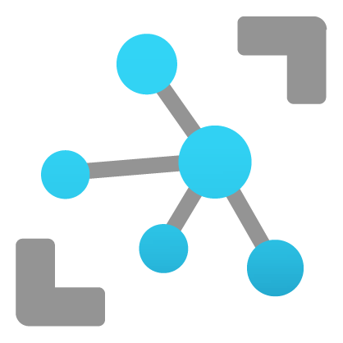

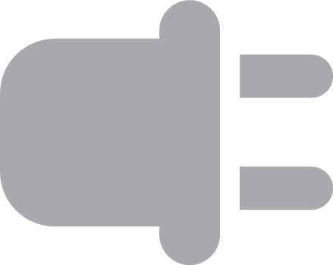

IoT-connected backends
SCENARIO EXAMPLE
Manufacturing
A manufacturing company uses IoT to monitor its machines. Functions detects anomalous data and triggers a message to Service department when repair is required
Connected IoT devices producing data
Data sent to IoT Hub
A function processes message...
…and calls Logic Apps
…which invokes Zendesk…
…to request device repair
Data with special condition routed to a function

Slide 29



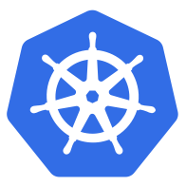

Azure application services
Run your apps, anywhere
App service
Functions
Logic Apps
API Management
Event Grid
Azure | On-premises | AWS | GCP
Notes:
Now in preview, customers don’t have to choose between the productivity of platform-as-a-service and the control of Kubernetes because the same application services can run with either model.
The application services are now Azure Arc-enabled, which means customers can deploy Web Apps, Functions, API gateways, Logic Apps and Event Grid services on pre-provisioned Kubernetes clusters, taking advantage of features including deployment slots for A/B testing, storage queue triggers, and out-of-box connectors from the application services regardless of where they run

Slide 30
Azure application services
Accelerate development with turnkey services
Flexibility between productivity of PaaS and control of Kubernetes
Write once, run anywhere with Azure Arc
Notes:
The three key benefits you get from using Azure application services are
Enable your development teams to accelerate their continuous development and deployment of their applications using purpose-built services
Your organization can now choose between hosting the PaaS services on Azure or on your own Kubernetes if added control is required or if the application needs to run outside of Azure
and lastly, with Arc, you can now build your applications once and run them anywhere

Slide 31


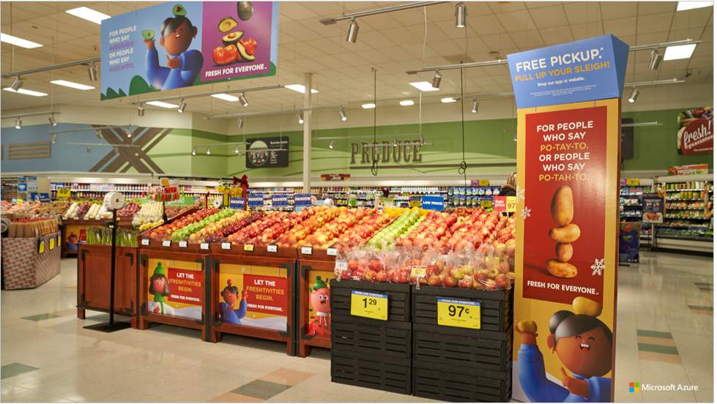




How are companies developing cloud native applications in the real world.

Slide 32
Global optics and photonics leader creates smart devices
CHALLENGE
ZEISS wanted to create smart devices that schedule their own service calls and give ZEISS designers predictive insight into customer needs. ZEISS needed to connect them to its back-end business systems, such as SAP, Salesforce, and others, where customer records, device data, service history, and other information was stored.
OUTCOME
Zeiss used Azure Functions, API Management, and Cosmos DB to create a digital integration architecture—the Enterprise Service Bus (ESB)—an interoperability platform that allows field devices to securely and easily connect to back-end business systems using a standard REST-based application programming interface (API).

Slide 33


“The scalability of Azure Functions is amazing. We can send out millions of records, and the platform adjusts automatically to the load.”
Kai Walter
Lead Solution Architect

Slide 34
East West Bank builds a modern platform on Azure to win new mobile customers
CHALLENGE
Senior leadership wanted a digital banking solution to reach new customers, including students, tourists, and working professionals in the United States and China, who do their banking online using mobile apps. The bank needed “a brand-new architecture that is built to scale and highly available.
OUTCOME
East West Bank built a cloud native digital platform that could elastically scale up and down based on changing requirements using Azure App Service, Events API, Azure Stream Analytics, Azure Cosmos DB, Azure SQL Database, and Azure Functions.
Notes:
https://customers.microsoft.com/en-us/story/finastra-fusion-fabric-cloud-azure

Slide 35
“Azure Stream Analytics, Azure Functions, Azure SQL Database, and Azure Cosmos DB are responsible for our biggest ROI.”
Rakesh Nambiar
Chief Digital Officer

Slide 36

Kroger dynamically manages inventory with Azure
CHALLENGE
One of their mission-critical applications is InStock, a solution that tracks store inventory and balance-on-hand for items across thousands of stores. Kroger estimates that InStock can drive up to $2.6B of recovered "lost sales" opportunities. InStock was limited by the capacity of Kroger’s datacenters—scaling on-premises systems take time.
OUTCOME
Kroger uses Azure Functions every time a purchase is made to update inventory in Cosmos DB. By moving to Azure, Kroger increased active store capacity from 300 stores to more than 2,500. InStock is currently helping delight customers by ensuring that the products they want are available in their local stores at the right time.
Notes:
https://customers.microsoft.com/en-us/story/finastra-fusion-fabric-cloud-azure

Slide 37
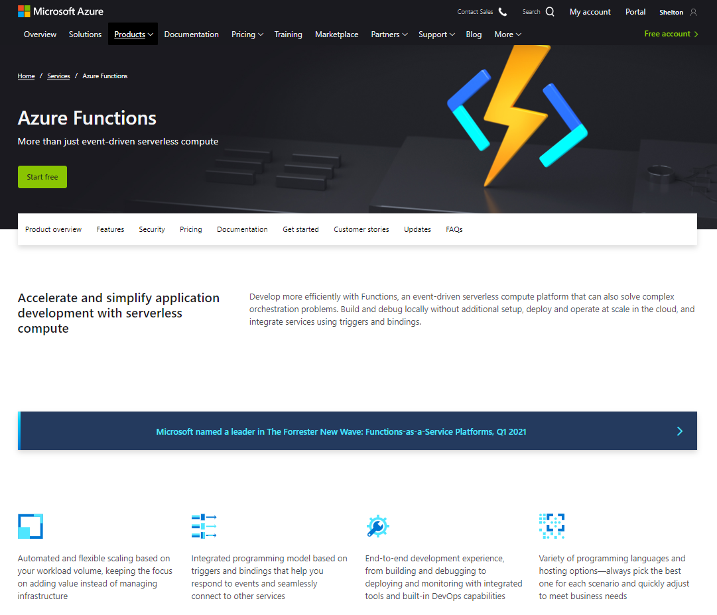
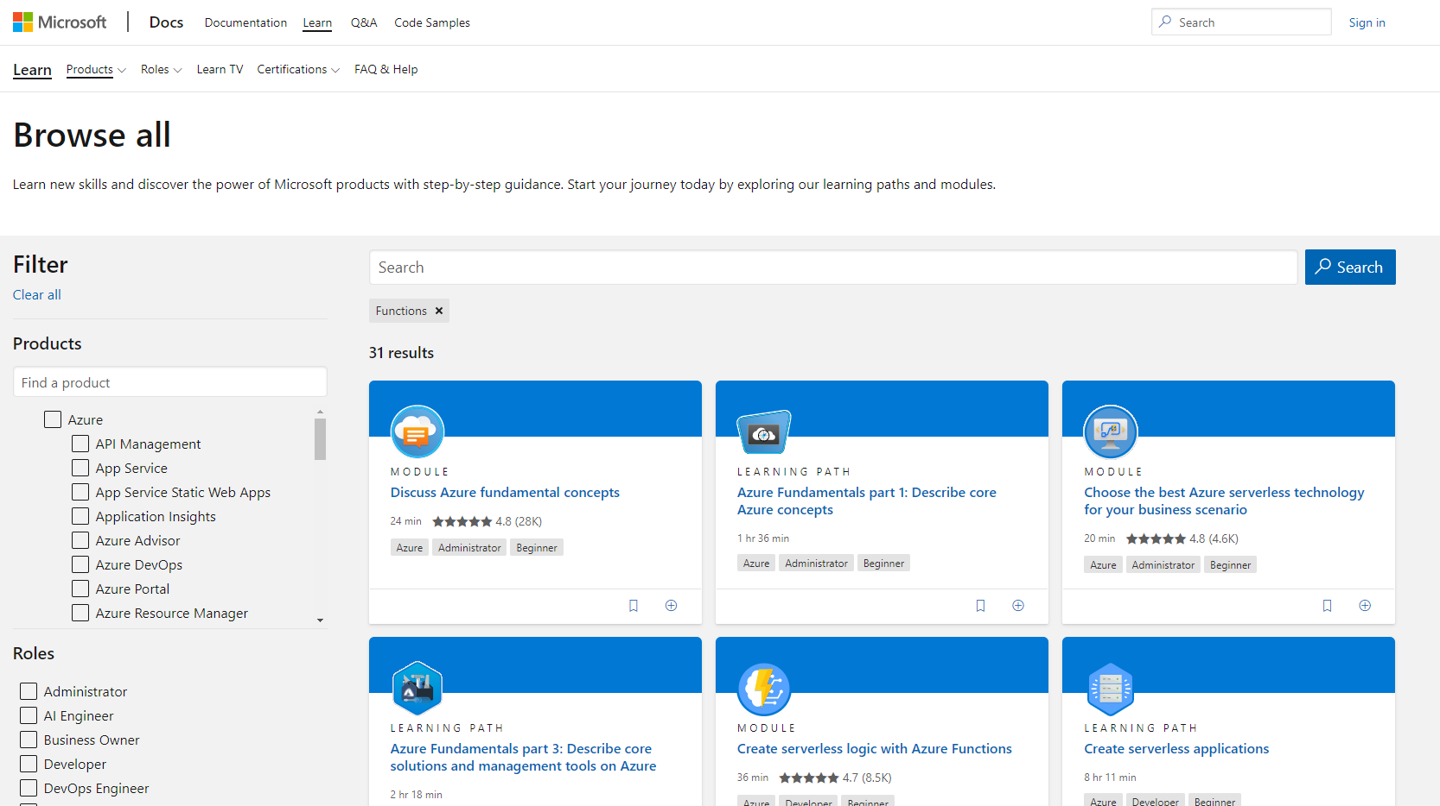
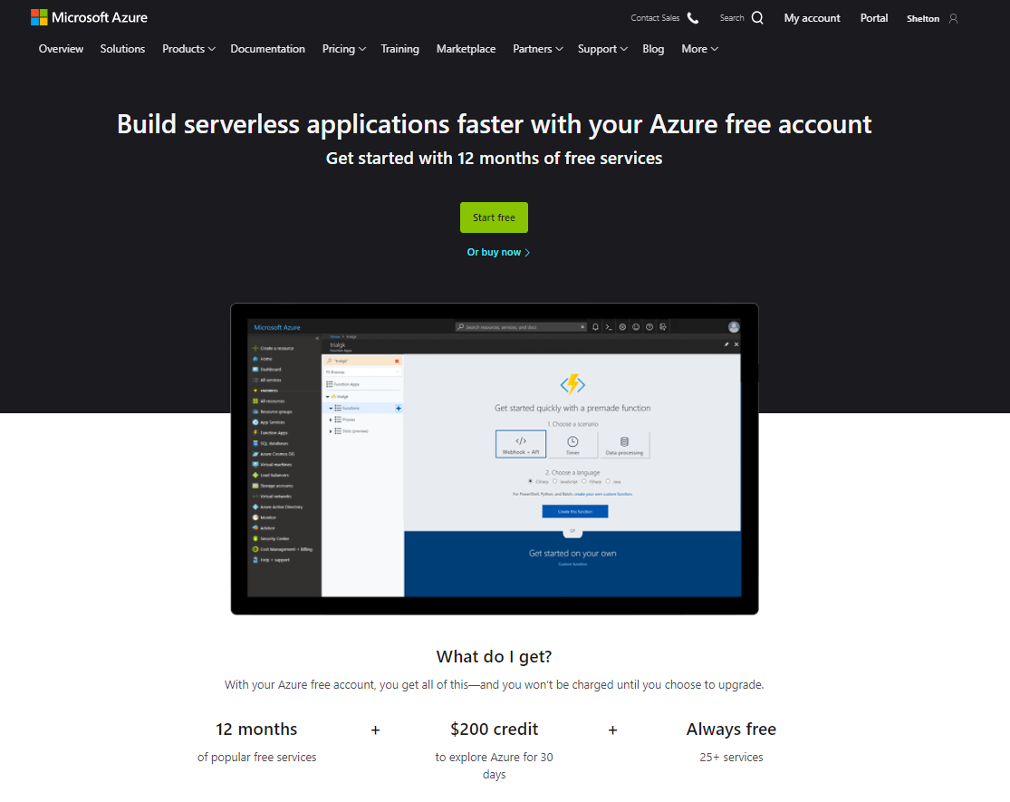
Ready to develop more efficiently with Azure Functions?
Get started today!
Learn more about Azure Functions
Building your skills with Azure Functions learning modules
Try Azure Functions free

Slide 38
Appendix

Slide 39


Boost development efficiency
Connect to data with input and output bindings
Bind to Azure solutions and third-party services
Use HTTP bindings in tandem with HTTP triggers
Bindings
Use triggers to define how functions are invoked
Avoid hardcoding with preconfigured JSON files
Build serverless APIs using HTTP triggers
Triggers
Debug C# and JavaScript functions locally
Use debugging tools in Azure portal, VS, and VS Code
Local debugging
Save time with built-in DevOps
Deploy functions using App Service for CI
Leverage Microsoft, partner services for CD
Integrate with Azure Application Insights
Get near real-time details about function apps
See metrics around failures, executions, etc.
CI/CD
Monitoring
Notes:
Additional information
Triggers and bindings – https://docs.microsoft.com/en-us/azure/azure-functions/functions-triggers-bindings
Monitoring—https://azure.microsoft.com/en-us/services/application-insights/
Local debugging—https://docs.microsoft.com/en-us/azure/azure-functions/functions-run-local#run-functions-locally
CI/CD—https://docs.microsoft.com/en-us/azure/azure-functions/functions-continuous-deployment
Run locally—https://docs.microsoft.com/en-us/azure/azure-functions/functions-run-local
Proxies—https://docs.microsoft.com/en-us/azure/azure-functions/functions-proxies

